Slide 1
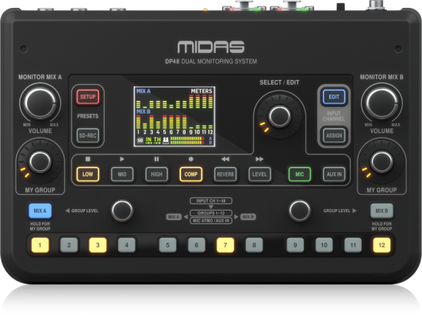
NAME
PERSONAL MONITOR MIXER
MODEL
DP48
제조사
MIDAS
Dual 48 Channel Personal Monitor Mixer
Connections
Phones Mix A / B : 2 x 1/4" TRS, stereo, unbalanced, 25 Ω
Line Mix A / B : 2 x 1/4" TRS, mono, balanced, 1 kΩ
2 x 1/4" TRS, mono, unbalanced, 500 Ω
Aux in : 2 x 1/4" TRS, unbalanced, 20 kΩ
2 x 1/4" TRS, balanced, 40 kΩ
AES50 Thru / In : 2 x RJ45
Output
Mix A / Mix B : 2 x stereo
AES50
Audio channels @ 48 kHz : 48
Sample rate : 44.1 / 48 kHz
Sample word length : 24 bit
Clock synchronization : AES50 IN
Latency : min. 70 µs per node (AES50)
Power Supply
AES50 input : PoE (IEEE802.3af)
Power consumption : max. 14 W (with DC adaptor)
Dimensions / Weight
Dimensions (H x W x D) : 69 x 242 x 164 mm
Weight : 1.3 kg

